Slide 1
Promoting active lifestyle in Kerava
Eeva Saarinen Head of sport and outdoor activities
Sara Hemminki Sport service coordinator
8.4.2024

Slide 2
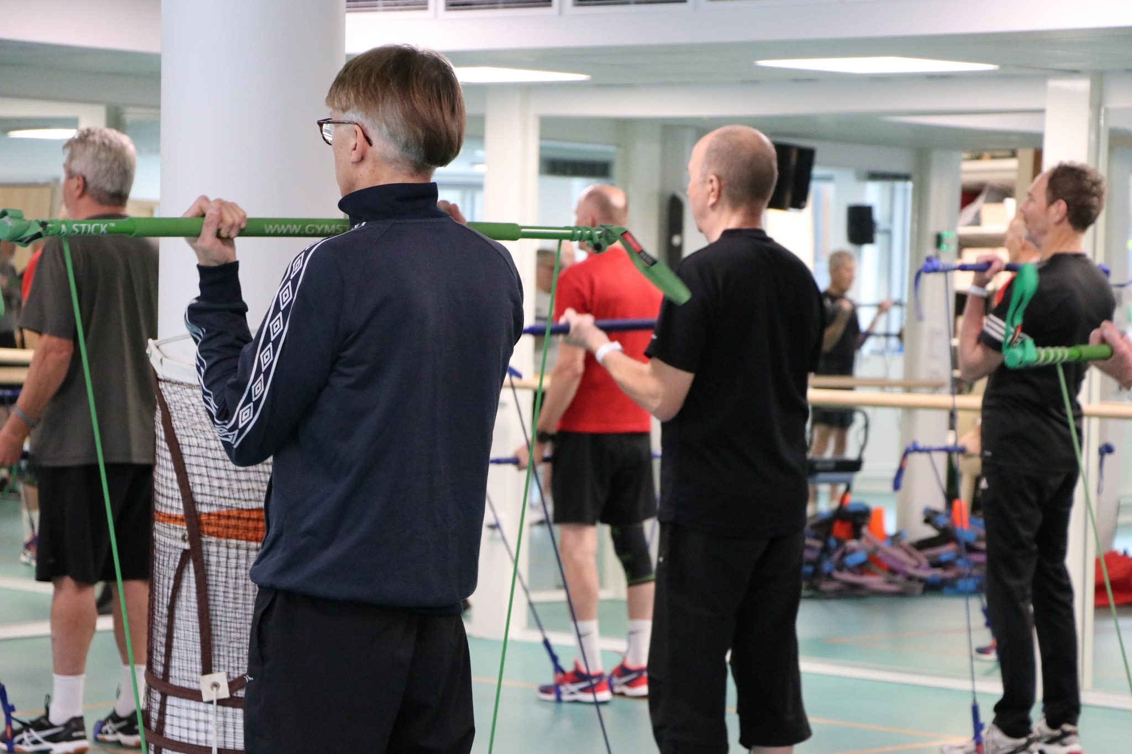
Kerava was in the final for "Finland's most active city 2023" at Urheilugaala
https://www.youtube.com/watch?v=qPsO_kSgEJ0

Slide 3
Physical activity in our strategy and policies
All our actions aim to produce wellbeing for our citizens
One of our strategic measures is that physical activity increases among citizens
We aim to make physical activity one of our city's success factors, to create premises for physical activity and to lower the barriers for physical activity
Everybody's right to daily active break is written in the curriculum
Notes:
2 So Each unit must set an annual goal to promote movement.
We measure it by excample we have digital meter for walkers and bikers and how our youth health is school health survey
3. our political decision-makers are also committed to promoting investments intended to promote an active lifestyle.
4. we are the first city in finland who has written the right to daily activity break in curriculum.

Slide 4
Infrastructure
Actively used sport facilities (swimming hall, ice rink etc)
Infrastructure supports walking and cycling
"Green area promise": Every citizen has max. 300 meters to the nearest green area
Notes:
3. Even though we are densely populated city, we are also keen to have green environment near every inhabitant. We have Green are promise so that..

Slide 5
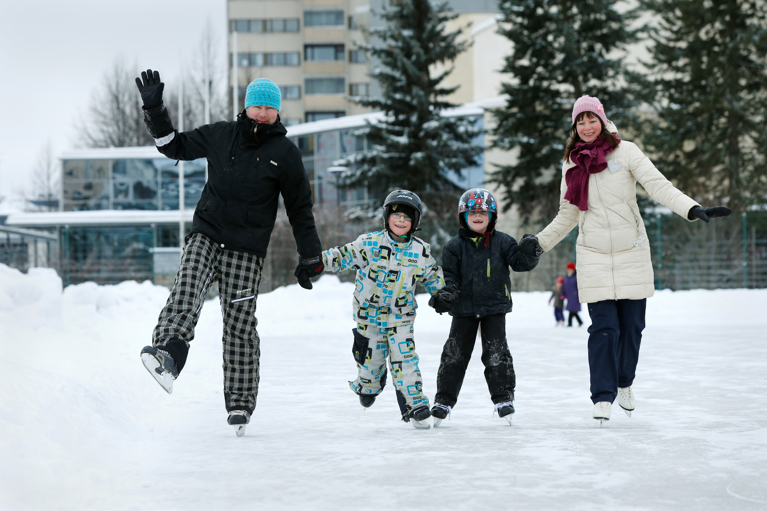
Sport services
Versatile supervised group exercises
Peer group exercise for seniors
Senior swimming card and special swimming card
Sport equipment in the library
Different sport events
Wellbeing mentoring
Notes:
1. Sport services offer a variety of group training, such as pilates, strength training, water exercise. We also have classes for those with special needs.
2. Trainer senior instructors organize light exercise classes to other seniors in different parts of the city. Mostly in aged groups
3. Senior cards and special swimming cards are cheap. Senior card is 80 e (you have to be 65 years old to get this card) per year and special swimming card is 70 e. You can get special swimming card right for a year if you for example recover from surgery or you have asthma.
4. you can lend for example skating support. kettlebell, handweights etc, with library card
5. We tend to add sport in different events so that sport is seen throught different occasions. We also have multiple own events throughout the year.
6. We have one wellbeing mentor who mentor clients to move, sleelp and eat right. Clients come straight from patient information system were doctors suscribe the need to have wellbeinf metoring done.

Slide 6
Collaboration
Strong collaboration within the city and with sport clubs and companies
Regular meetings with sport clubs representatives
Joint swimming cards and outdoor routes with neighbour cities
Kerava-Sipoo sports hall
Collaboration with Vantaa and Vantaa-Kerava wellbeing services county
Notes:
2. We have two meatings in year were every club in Kerava is envited and then we have a sport parliament. Sport parliament has 6 persons from different clubs. clubs have voted people into the sports parliament and i as the director of sport have agreed to move the thigs forward what the parlament sees as needed.
3. We have joint swimming card with Tuusula and Järvenpää, so that if you have 10 times swimming card purcased you can use that in all of yhese three swimming hall. We are the only citys in finland to have this kind of co-operation.
4. We are planning to built a big sport hall with our neighbour city Sipoo. This is also the first one in Finland and we also got higher grant (one miljon) from the state for construction. The total costs are aproximately 18-20 miljon.

Slide 7
Physical activity in daycare and in schools
Every pupil's right for daily break acitivity
Fiksusti kouluun –programme to support active school transport
Sports van
Physical activity play school
Green playareas in kindergardens as nature-filled outdoor spaces that offer kids, teachers, parents and community members places to play, learn, explore and grow
Urhea-action
Notes:
Every pupil in Kerava has a right to do daily break activity in addition to normal breaks between classes. In addition they have one longer break between classes
Two schools in Kerava have so far attended, we have made surveys to make the school environment and schoolway more safe for biking
Two sport vans with sport and game equipment goes around kindergartens
We have invested in green playareas in kindergartens
Urhea-toiminta middle-school pupils to combine school and goal oriented sports hobby

Slide 8
Grants
We support sport clubs with different grants
Child families can apply for a grant for hobby expenses (co-operation with Sinerbrychoff).
Successfull athletes can be granted
Kerava has two sponsor athletes (Eveliina Määttänen and Janette Ylisoini)
Notes:
We have grants to support sports clubs basic operations as well as grant for special occassions such as organizing sport events
Hobby stipend for 7-17 year old children to support attwnding organized hobby. Hobby voucher for 7-28 year olds for any kind of hobby, hobby equipment etc
Athletes who have gold medal in national championships or who are in the national team can be granted
Sponsor athletes promote Kerava in social media and Kerava offers them small financial support

Slide 9
Kiitos!

